Slide 1

Notes:
Well, we have come to the end of our Sermon on the Mount series, a 17-week series which began last fall. In Matthew 5-7, Jesus proclaims the good news and casts a vision of what it looks like to live in right relationship with God, our neighbors, and our enemies.
We have learned in this series that the Sermon on the Mount contains the core of Jesus’ teachings and his most well-known sayings. If you want to understand why the way of Jesus is so radically different than what many evangelicals have believed about Christianity, then look no further than the Sermon on the Mount. For it’s in this sermon that we get the undiluted, unfiltered, and uncensored Jesus.
Beginning with the beatitudes… [NEXT SLIDE]

Slide 2
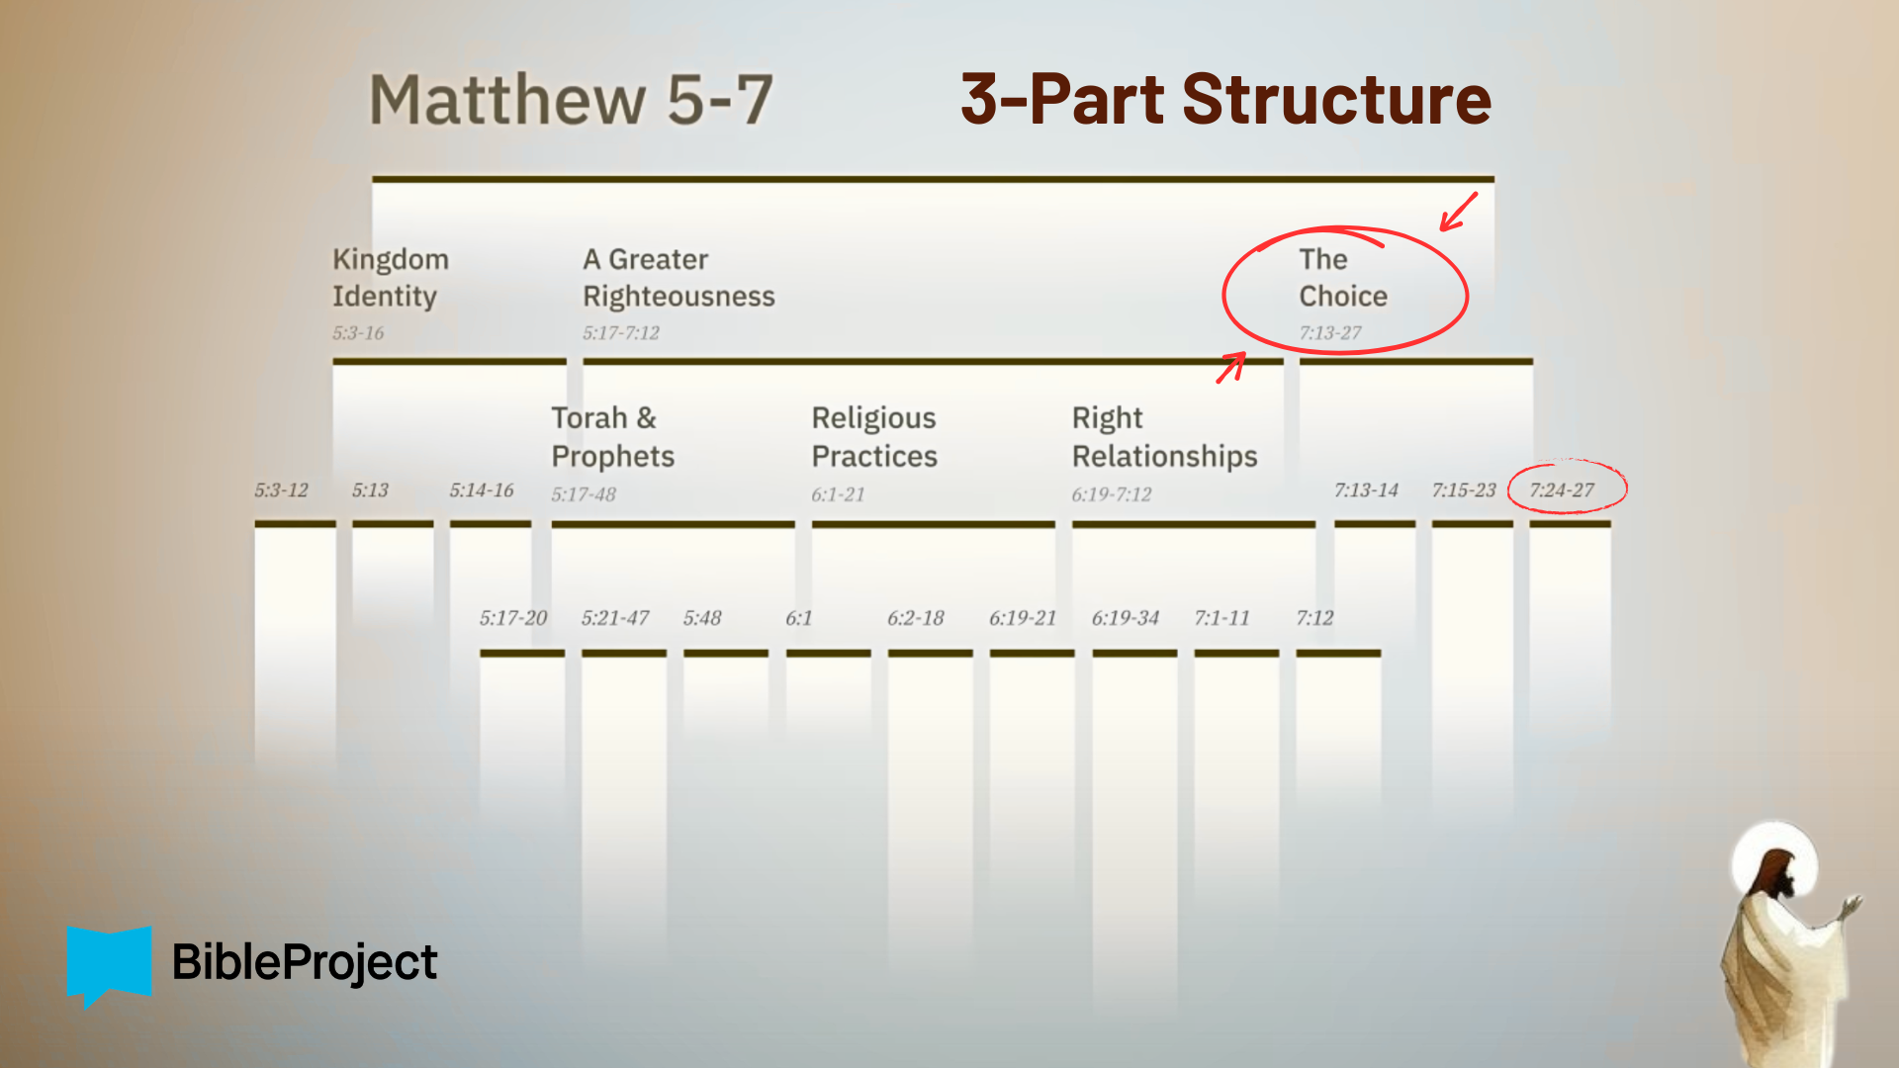
Notes:
…we hear Jesus inviting people the world would least expect to join his Kingdom movement; to accept our Kingdom identity as disciples and reimagine how we should relate to God and other people. Jesus and the writers of the NT refer to this as “righteousness” – living in right relationship with God and others; or what it looks like when we are loving God and our neighbor in the way of Jesus.
Last week we began the final section of the Sermon on the Mount—where Jesus gives us a choice as to whether we will follow his teachings, seek the Kingdom, and work toward a “greater righteousness” than that of the average Pharisee and religious person on the street, or simply follow the crowd. Using three images (two roads, two trees, and, in this final message, two houses), the Lord invites us to choose how we will respond. Will we be hearers only, or doers? Will we be fans or followers? Will we be passive receivers or faithful practitioners of his way of life?
If you’re taking notes, I’ve entitled today’s message… [NEXT SLIDE]

Slide 3
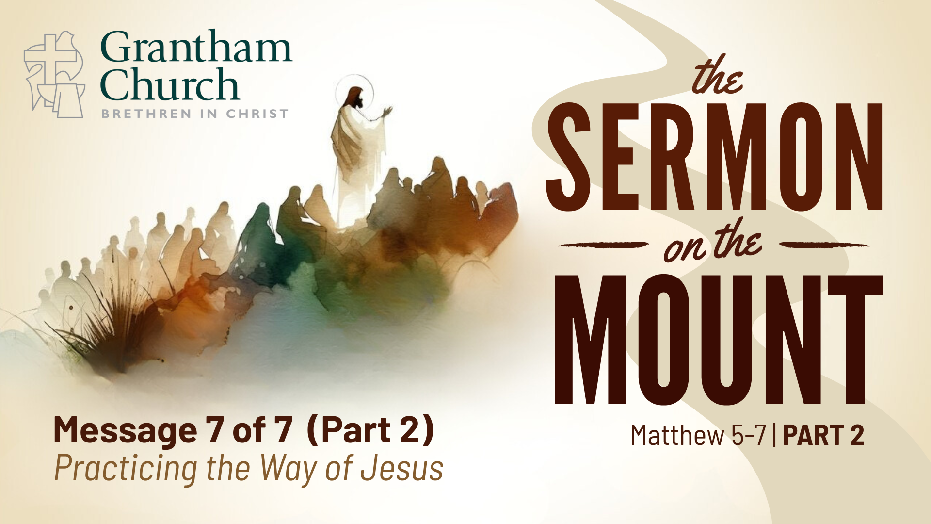
Notes:
Practicing the Way of Jesus.
[BRIEF PRAYER]
Please open your Bibles to our main Scripture reading… [NEXT SLIDE]

Slide 4
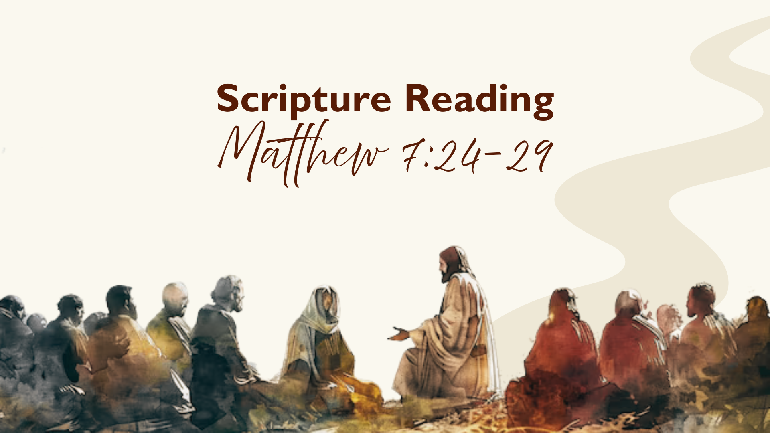
Notes:
Matthew 7:24-29. [INVITATION TO STAND FOR SCRIPTURE READING]
[READ SCRIPTURE] This is the word of the Lord. Thanks be to God. You may be seated.
I recently came across a story where a coastal community built a beautiful new neighborhood near the water. The homes were stunning — wide porches, bright windows, fresh paint, everything looked perfect from the street. People were proud to live there. But when the first major hurricane hit, something surprising happened. Some houses stood firm, while others collapsed almost overnight. Later, inspectors discovered the difference wasn’t the design, the furniture, or the color of the walls — it was the foundation. Some builders had taken shortcuts underground where no one could see. From the outside, all the houses looked the same. The storm simply revealed what had been true all along: the houses that collapsed were not built on a firm foundation.
Here at the end of the Sermon on the Mount, Jesus says that our lives work the same way. So, let’s return to our main Scripture reading and listen closely as we go verse-by-verse… [NEXT SLIDE]

Slide 5

Notes:
[READ VERSE-BY-VERSE & COMMENT]
v. 24 – “on the rock” – What does Jesus mean? He seems to have in mind three things: (1) a city on a hill; (2) Zion/temple; and (3) himself and his teachings; the invitation is to be a wise person who builds their life on Christ.
v. 25 – So, a storm is coming. In the Hebrew Bible, the raging sea, storms, and floodwaters (like in the time of Noah) are not viewed merely as natural events; they also have spiritual significance. Often, we see storms and floods as a consequence of human sin and evil, even as a result of demonic powers (Mk.4 – “rebuked”). And so, the coming storm could be a number of things. I’ll say more about that in a minute. But the wise person will weather whatever storm may come because they’ve built their life upon Christ.
Verse 26… [NEXT SLIDE]

Slide 6
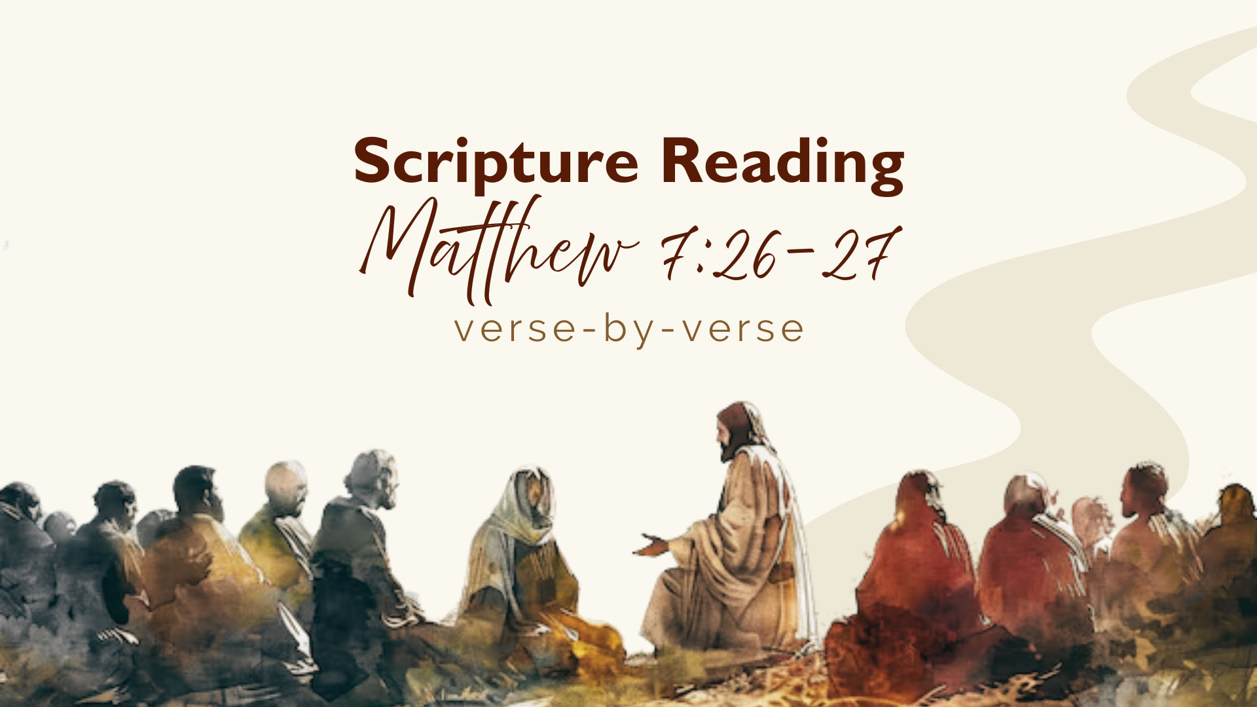
Notes:
v. 26 – “does not put them into practice” – notice, the “foolish” person (Gk:moros; English:moron) is not only the person who outright rejects Jesus (that would be foolish), but it’s also the person who doesn’t put his words into practice--who doesn’t become a learner and practitioner of the way of Jesus.
v. 27 – “great (mega) crash” – In other words, refusing to put the words and way of Jesus into practice will lead to a horrific disaster; ultimately, to an eternal destruction; sobering words.
Now, the “storm” or “flood” – in Jesus’ immediate context would have conjured up the history of Israel; prophets like Isaiah, Jeremiah, and Ezekiel speak of storms and floods coming in the form of Israel’s enemies (e.g., Assyria and Babylon). In Jesus day, the oppressor is Rome, and the threat is the destruction of Jerusalem. And this is coming because of their refusal to repent. In Matthew 24, Jesus will warn of this coming destruction. You’ll recall a chapter before, Jesus wept over Jerusalem, saying: “Jerusalem, Jerusalem, you who kill the prophets and stone those sent to you, how often I have longed to gather your children together, as a hen gathers her chicks under her wings, and you were not willing.” What is he talking about? He is saying, “I’ve proclaimed the good news, I’ve shown you a better way, I’m the only one who can save you, but you refused to turn from your own way.”
So, think about this… what is the personal storm that you’re going through? What is the national flood that we see coming? What is the global flood? And, of course, there is a cosmic flood that is coming for us all: death. What are we doing ahead of the storm to survive with Jesus? Are we building our lives upon him and walking his narrow way, or will we be one of those folks outside the ark?
Lastly, verses 28-29… [NEXT SLIDE]

Slide 7
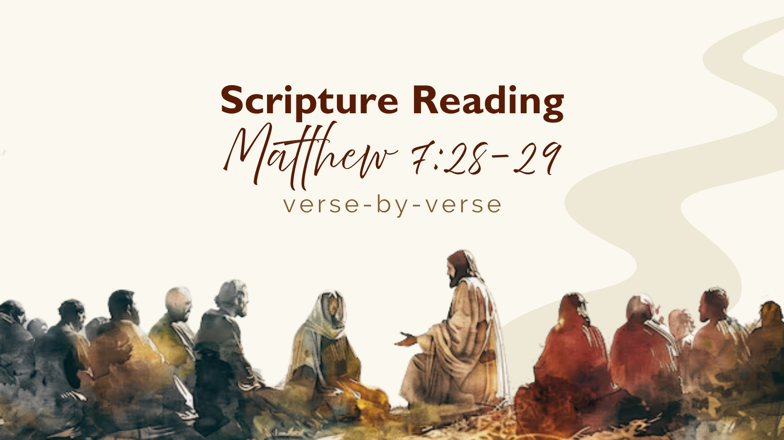
Notes:
[READ VERSE-BY-VERSE & COMMENT]
v. 28-29 – First, notice, Jesus places Himself above all other teachers, speaks without citating other rabbis, and demands total allegiance. This most certainly points toward Jesus’ divine identity and authority. And the people are amazed, but, yet… Matthew does not say they obey. Why? Well, there all kinds of reasons why people don’t choose to follow. But one thing is for sure, amazement does not equal discipleship. Throughout Matthew, crowds often admire Jesus but do not follow him.
You see, these verses hint at a tension: Will we just be impressed — or will we obey? Brothers and sisters, Jesus is not asking for our applause, but for our obedience. He speaks with God’s authority. Therefore, the Sermon on the Mount is not an invitation to admire. It is a call to submit and surrender to his way; to build our our lives on the rock of Jesus and his teachings.
So how do we do that? In his book, Practicing the Way, John Mark Comer draws from ancient Jewish discipleship practices and summarizes following Jesus in three movements… [NEXT SLIDE]

Slide 8
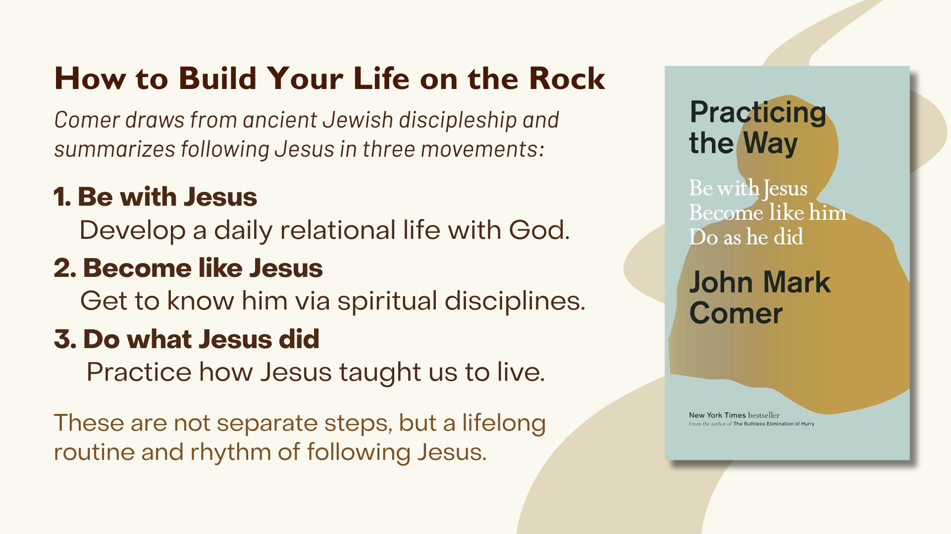
Notes:
[READ & COMMENT ON EACH POINT]
Be with Jesus. Develop a daily relational life with God. Disciples in Jesus’ day went everywhere their rabbi went. Proximity shaped transformation. This means walking with God in private devotion as well as within a worshipping community. If we’re going to build our life on the rock, we must create space to be with Jesus, which includes being with others who are on the Jesus journey.
Become like Jesus. Get to know him via spiritual disciplines. Spiritual formation is not about information, but about transformation. The goal is not more Bible knowledge, better arguments, and more church activity. The goal is more Christlike character; especially love, joy, peace, patience, kindness, goodness, faithfulness, gentleness, and self-control; This happens through regular times of prayer, Scripture reading, silence, contemplation, worship, etc. Getting to know and becoming like Jesus requires intentionality.
Do what Jesus did. Practice how Jesus taught us to live. Jesus said, if you want to know my Father’s will, then do what I say. And the more we come to know Jesus… watch this… our character changes and then our behavior and way of life follows. This includes how we love our neighbors and our enemies, practicing forgiveness, generosity, hospitality, living simply, serving the poor, addressing injustice, peacemaking, speaking truth in love, and walking wisely in this fallen world. To do this, we must be learners and apprentices of Jesus. We will stumble. But we can stumble forward in Jesus.
And so, we’re invited to make Jesus central and supreme in our lives. Listen to what the Apostle Paul wrote to the Philippians… [NEXT SLIDE]

Slide 9
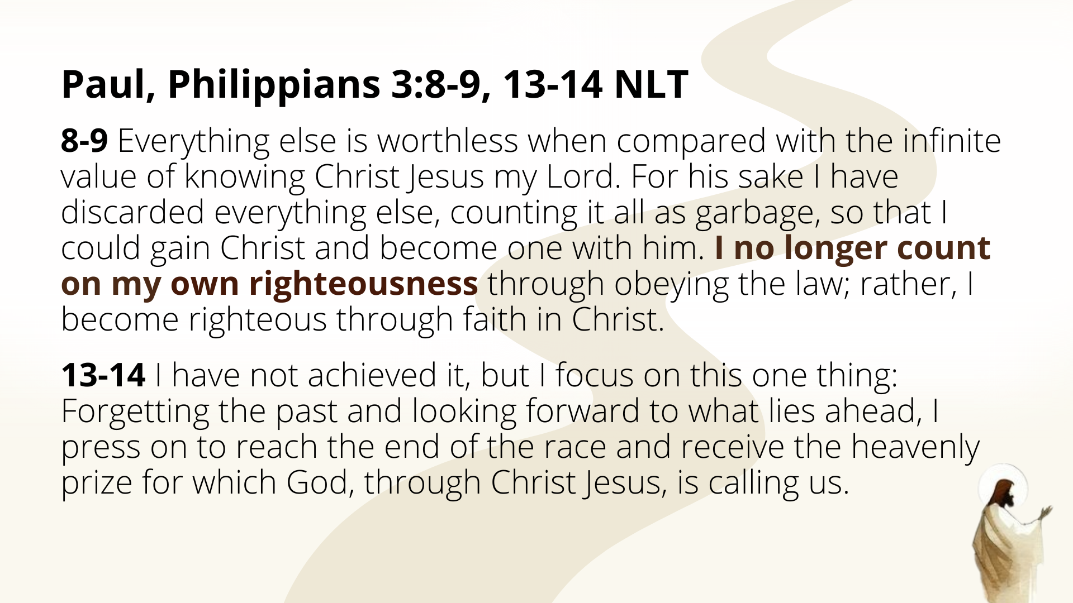
Notes:
[READ VERSES 8-9 & COMMENT]
vs. 8-9 - “my own righteousness” – i.e., what I’ve tried to do to be in right relationship with God and others in my own way or by following rules and regulations; I’m done with that! Paul says, I know now that I only need to trust Christ; he will do this work in me by faith.
[READ VERSES 13-14]
Finally, here are some takeaways and questions to consider… [NEXT SLIDE]

Slide 10
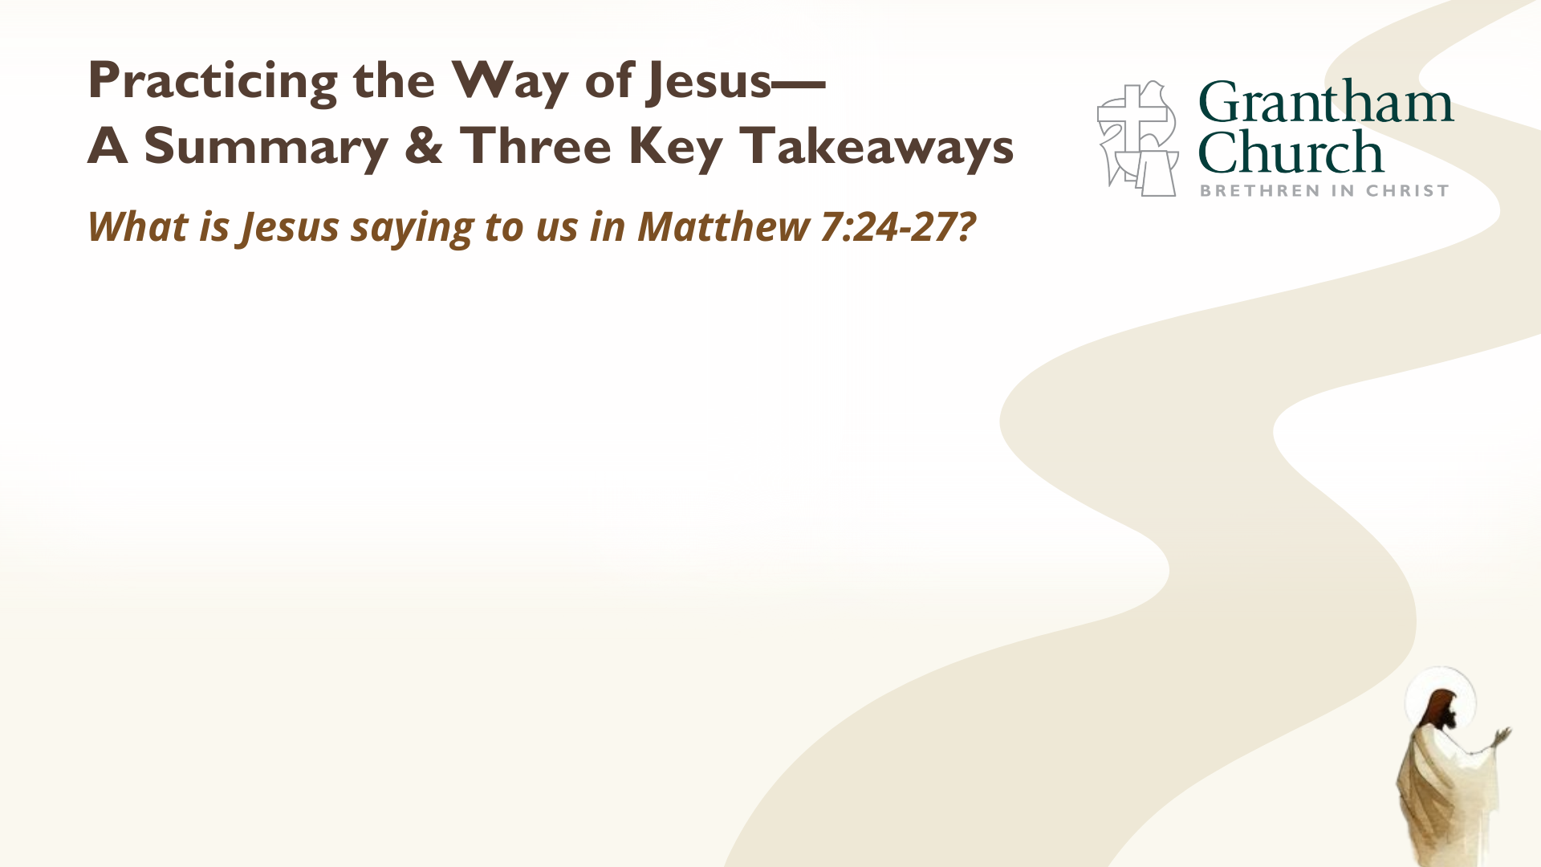

Slide 11
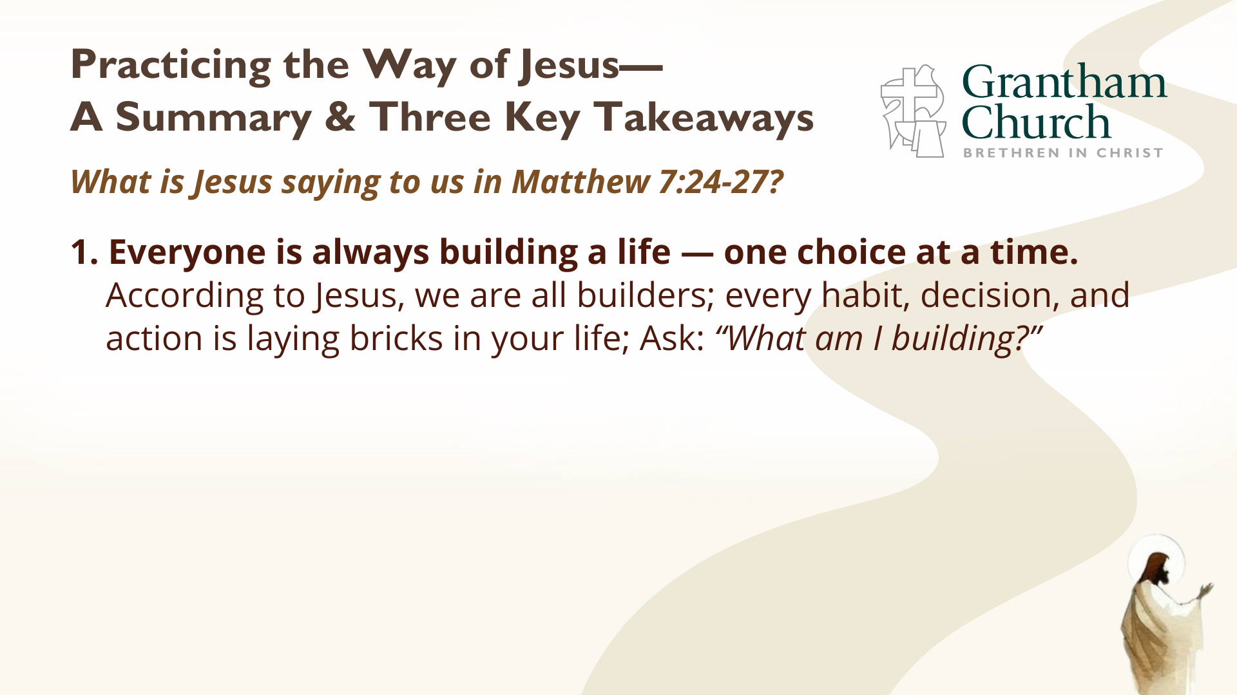

Slide 12
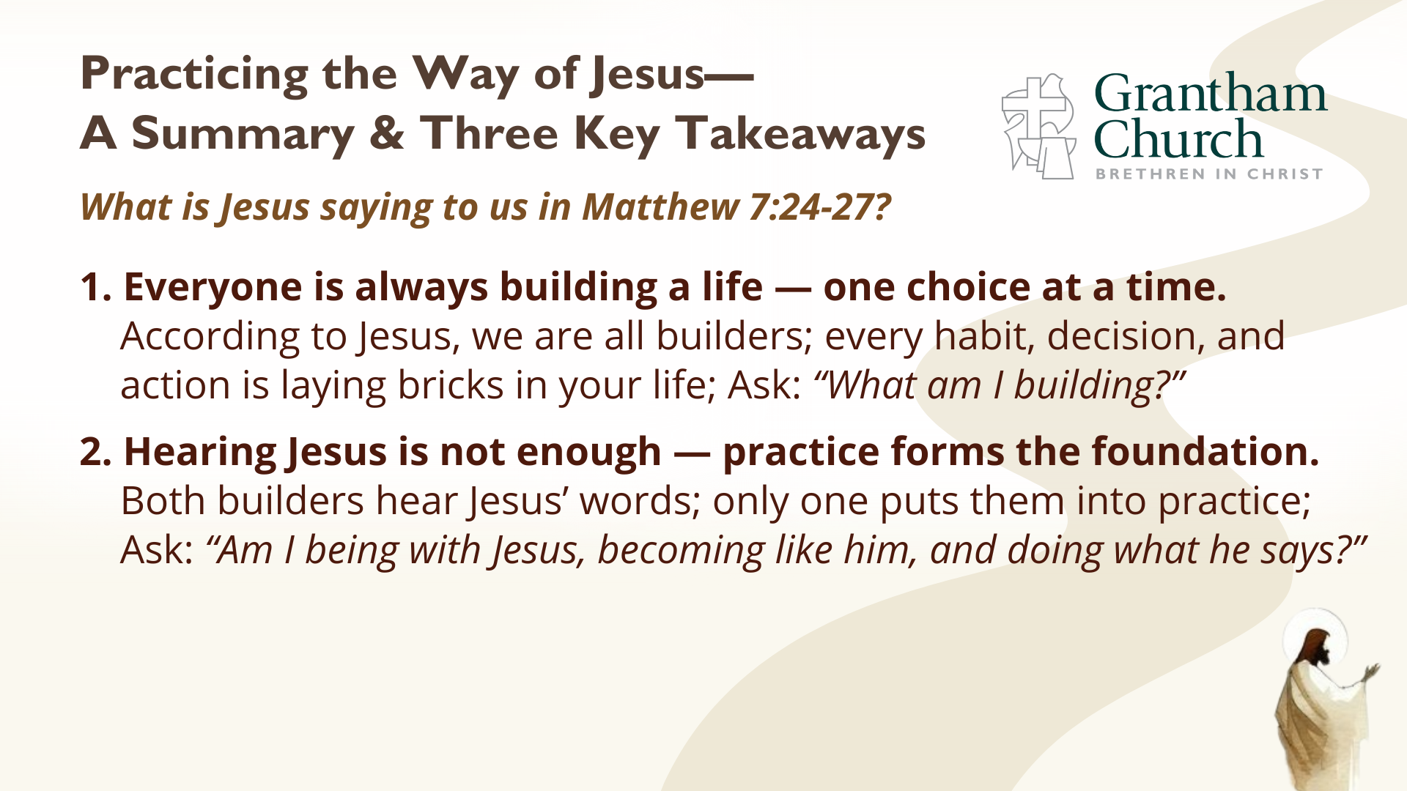

Slide 13
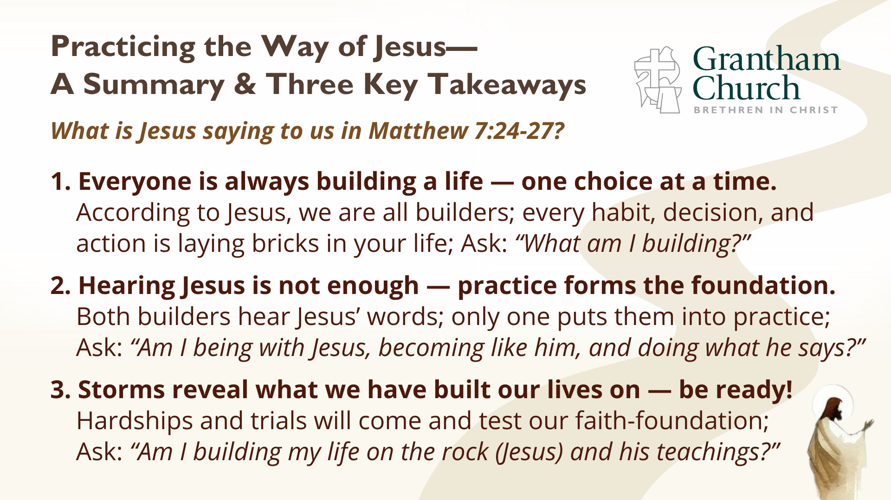
Notes:
[READ & BRIEF COMMENT ON EACH POINT]
1. Everyone is always building a life — one choice at a time.
According to Jesus, we are all builders; every habit, decision, and
action is laying bricks in your life; Ask: “What am I building?”
2. Hearing Jesus is not enough — practice forms the foundation.
Both builders hear Jesus’ words; only one puts them into practice;
Ask: “Am I being with Jesus, becoming like him, and doing what he says?”
3. Storms reveal what we have built our lives on — be ready!
Hardships and trials will come and test our faith-foundation.
Ask: “Am I building my life on the rock (Jesus) and his teachings?”
This morning I’ve invited a special guest to help us close out our series on the Sermon on the Mount… [NEXT SLIDE]

Slide 14
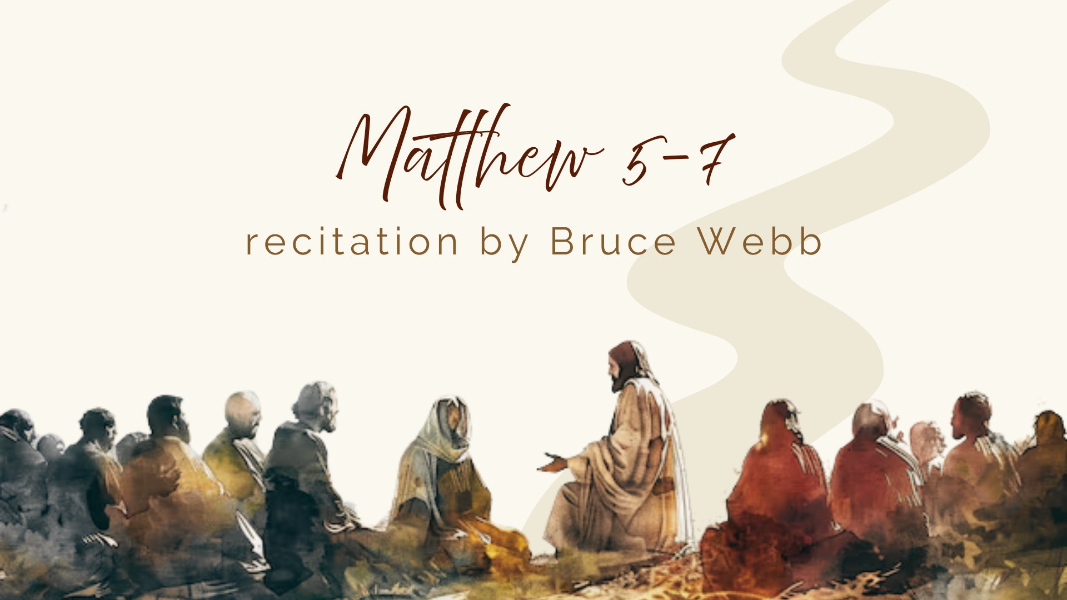
Notes:
[INTRODUCE BRUCE WEBB]
I invite us to listen with open hearts and minds as Bruce shares with us the words of Jesus
[BRUCE WEBB RECITES THE ENTIRE SERMON ON THE MOUNT – 18 mins]
[GO TO NEXT SLIDE FOR CLOSING WORDS & PRAYER]

Slide 15
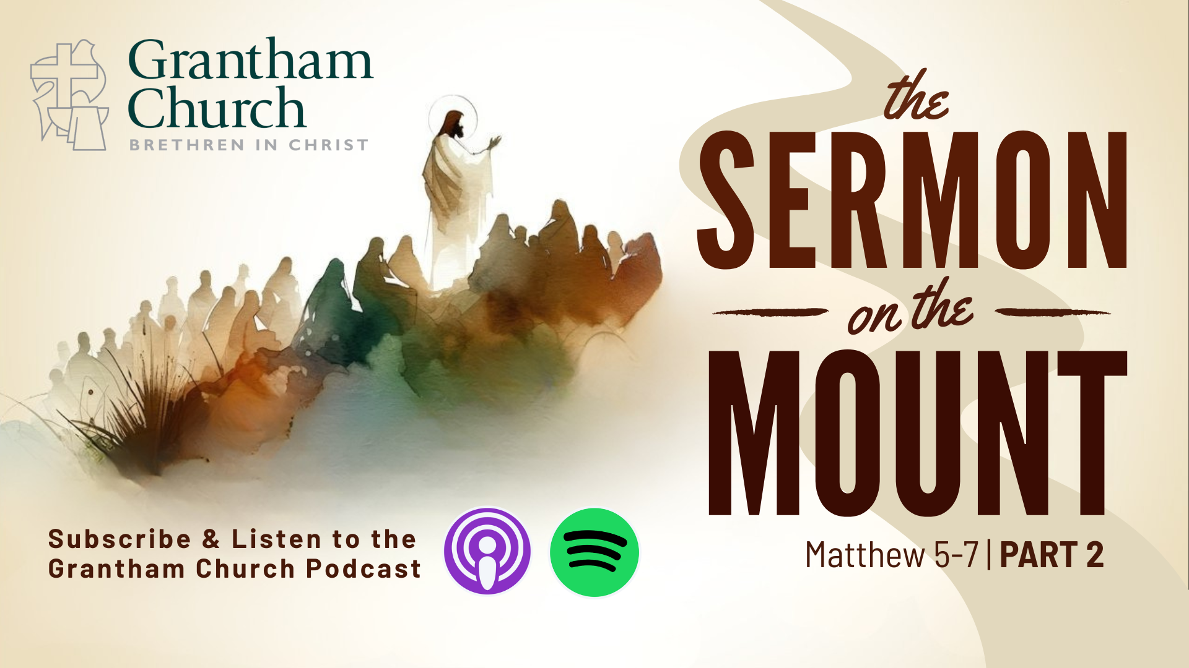
Notes:
[CLOSING PRAYER]
[ANNOUNCEMENTS]
Reminder about…
Fellowship Meal
Ordination Service at 7:00 pm
Benediction
Brothers and sisters, you have heard the words of Jesus and the call to follow him. The path is narrow, but it leads to life. Remember that Christ walks with you, the Father surrounds you, and the Spirit empowers you. Therefore, go in peace, to love and serve the Lord. Amen.

